Slide 1






SPACE INVADERS CLONE
A RETRO STYLE SPACE GAME

Slide 2




OUR TEAM
i. M.M. Rubaiet Ahmed (2512223042) ii. Noshin Islam (2511819642) iii. Mahin Ahmad (2413417042)
iv. Md. Nafiz Rahman (2511238042)
M.M. RUBAIET AHMED
NOSHIN ISLAM
GROUP 8
MAHIN AHMAD
MD. NAFIZ RAHMAN

Slide 3



INTRODUCTION
The Space Invaders Clone project recreates the experience of the original arcade game using C programming and console graphics. The purpose of this project is to build a simple 2D shooter game that involves basic gameplay mechanics such as player-controlled spaceship movement, shooting bullets, and enemy alien movement. The project is built with the following goals:
Understanding game loops and real-time input management.
Implementing collision detection between bullets and aliens.
Learning how to manage game entities (spaceship, aliens, bullets) using functions.
Enhancing gameplay with features like scoring and a game-over condition
M.M. RUBAIET AHMED
NOSHIN ISLAM
GROUP 8
MAHIN AHMAD
MD. NAFIZ RAHMAN

Slide 4




KEY COMPONENTS
Spaceship Movement: Controlled by the player to move left and right, up and down !
Bullets and Aliens: Bullets fired by the spaceship to destroy aliens. Boom Boom! Also look out for the enemies that move down the screen, aiming to catch your spaceship.
Collision and Game Over Condition: If any alien reaches you, the game ends (oh no!). Score is earned by destroying aliens.
M.M. RUBAIET AHMED
NOSHIN ISLAM
GROUP 8
MAHIN AHMAD
MD. NAFIZ RAHMAN

Slide 5


GAME INITIALIZATION
Spaceship Position: This is set at somewhat left of the screen.
Alien position: Aliens are set to spawn down randomly
starting from the top left of the screen.
Bullet Status: Initially set to -1 meaning inactive bullet status. Score: is initialized to 0.
Alien speed: alienMoveCounter is set to 0 originally until they come into play.
M.M. RUBAIET AHMED
NOSHIN ISLAM
GROUP 8
MAHIN AHMAD
MD. NAFIZ RAHMAN

Slide 6





FUNCTIONS BREAKDOWN
CLEARSCREEN(): CLEARS THE CONSOLE SCREEN TO REFRESH THE GAME DISPLAY.
DISPLAYSPACESHIP(): DISPLAYS THE SPACESHIP AT ITS CURRENT POSITION. MOVESPACESHIP(): MOVES THE SPACESHIP BASED ON USER INPUT (W,A,S,D).
SHOOTBULLET(): FIRES A BULLET FROM THE SPACESHIP.
UPDATEBULLET(): MOVES THE BULLET UPWARD AND RESETS WHEN OFF-SCREEN. SPAWNALIENS(): RANDOMLY SPAWNS NEW ALIENS WHEN NECESSARY.
MOVEALIENS(): MOVES ALIENS DOWN THE SCREEN AND CHECKS IF ANY NEED RESPAWNED.
CHECKCOLLISIONS(): CHECKS IF A BULLET HITS ANY ALIEN AND UPDATES THE GAME STATE.
ISGAMEOVER(): TRIGGERS GAME OVER IF COLLISION IS MET.
M.M. RUBAIET AHMED
NOSHIN ISLAM
GROUP 8
MAHIN AHMAD
MD. NAFIZ RAHMAN

Slide 7


GAME FEATURES
Spaceship Movement: Controlled by the player with the ‘A, ‘D', ‘W', and ‘S' keys to go left, right, up and down.
Bullet Firing: Pressing ‘Enter’ will shoot a bullet.
Alien Movement: Aliens move down from the top of the screen at random intervals.
Collision Detection: Bullets can destroy aliens, and aliens can collide with the spaceship.
Game Over: The game ends if any alien catches the shapceship.
Score: The player earns a single point for each alien destroyed.
M.M. RUBAIET AHMED
NOSHIN ISLAM
GROUP 8
MAHIN AHMAD
MD. NAFIZ RAHMAN

Slide 8


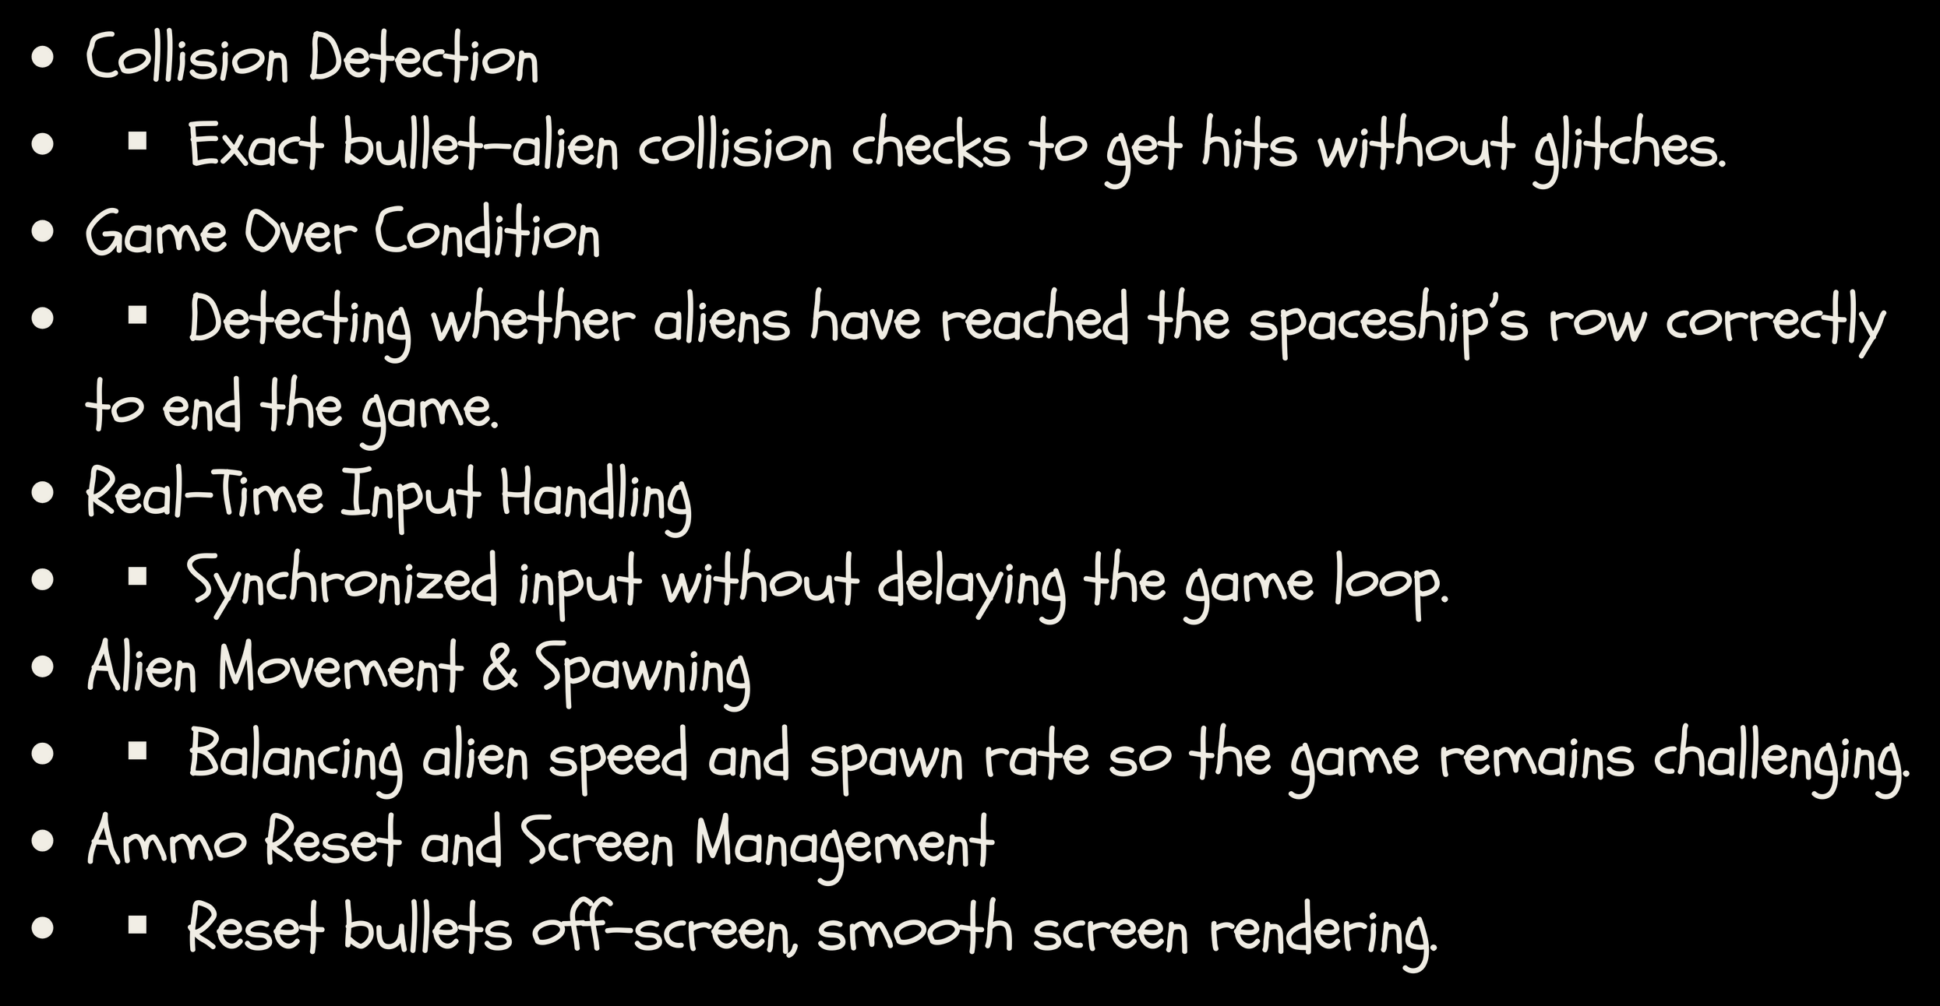


CHALLENGES
Ihoi
M.M. RUBAIET AHMED
NOSHIN ISLAM
GROUP 8
MAHIN AHMAD
MD. NAFIZ RAHMAN

Slide 9
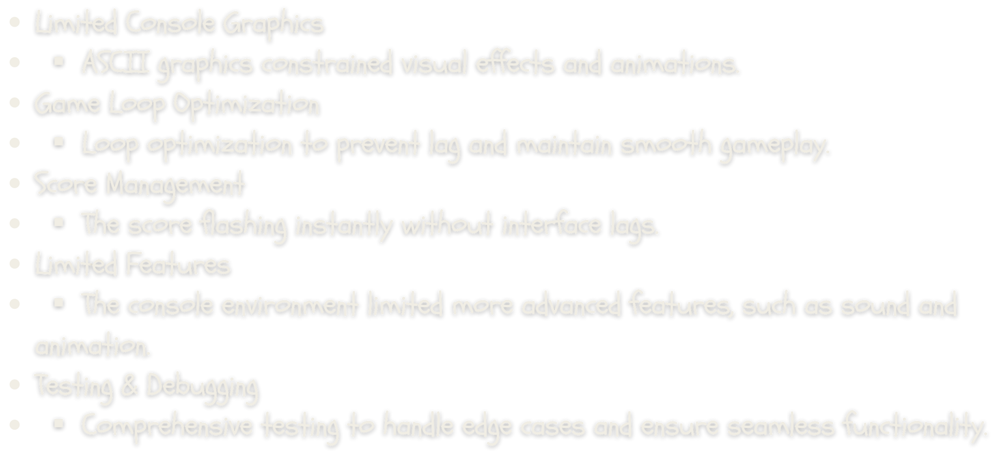

CHALLENGES
M.M. RUBAIET AHMED
NOSHIN ISLAM
GROUP 8
MAHIN AHMAD
MD. NAFIZ RAHMAN

Slide 10

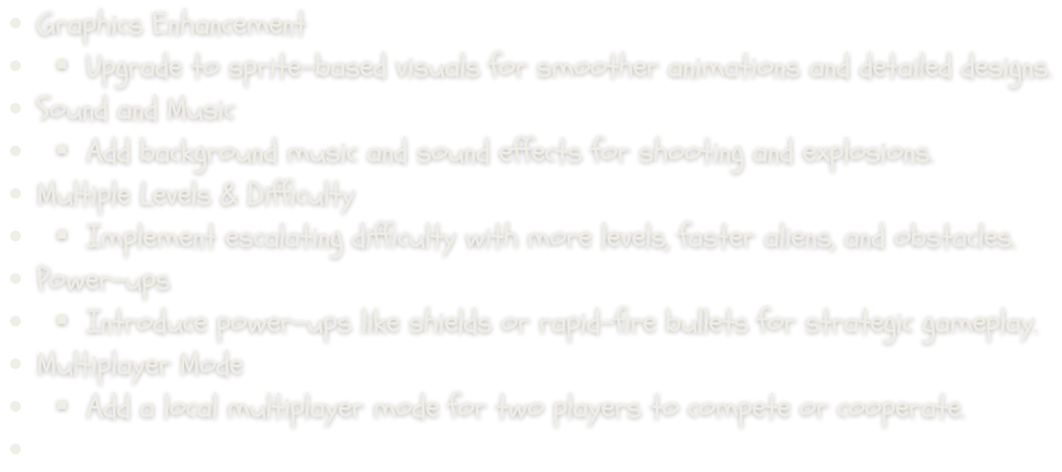
FUTURE ENHANCEMENTS
M.M. RUBAIET AHMED
NOSHIN ISLAM
GROUP 8
MAHIN AHMAD
MD. NAFIZ RAHMAN

Slide 11
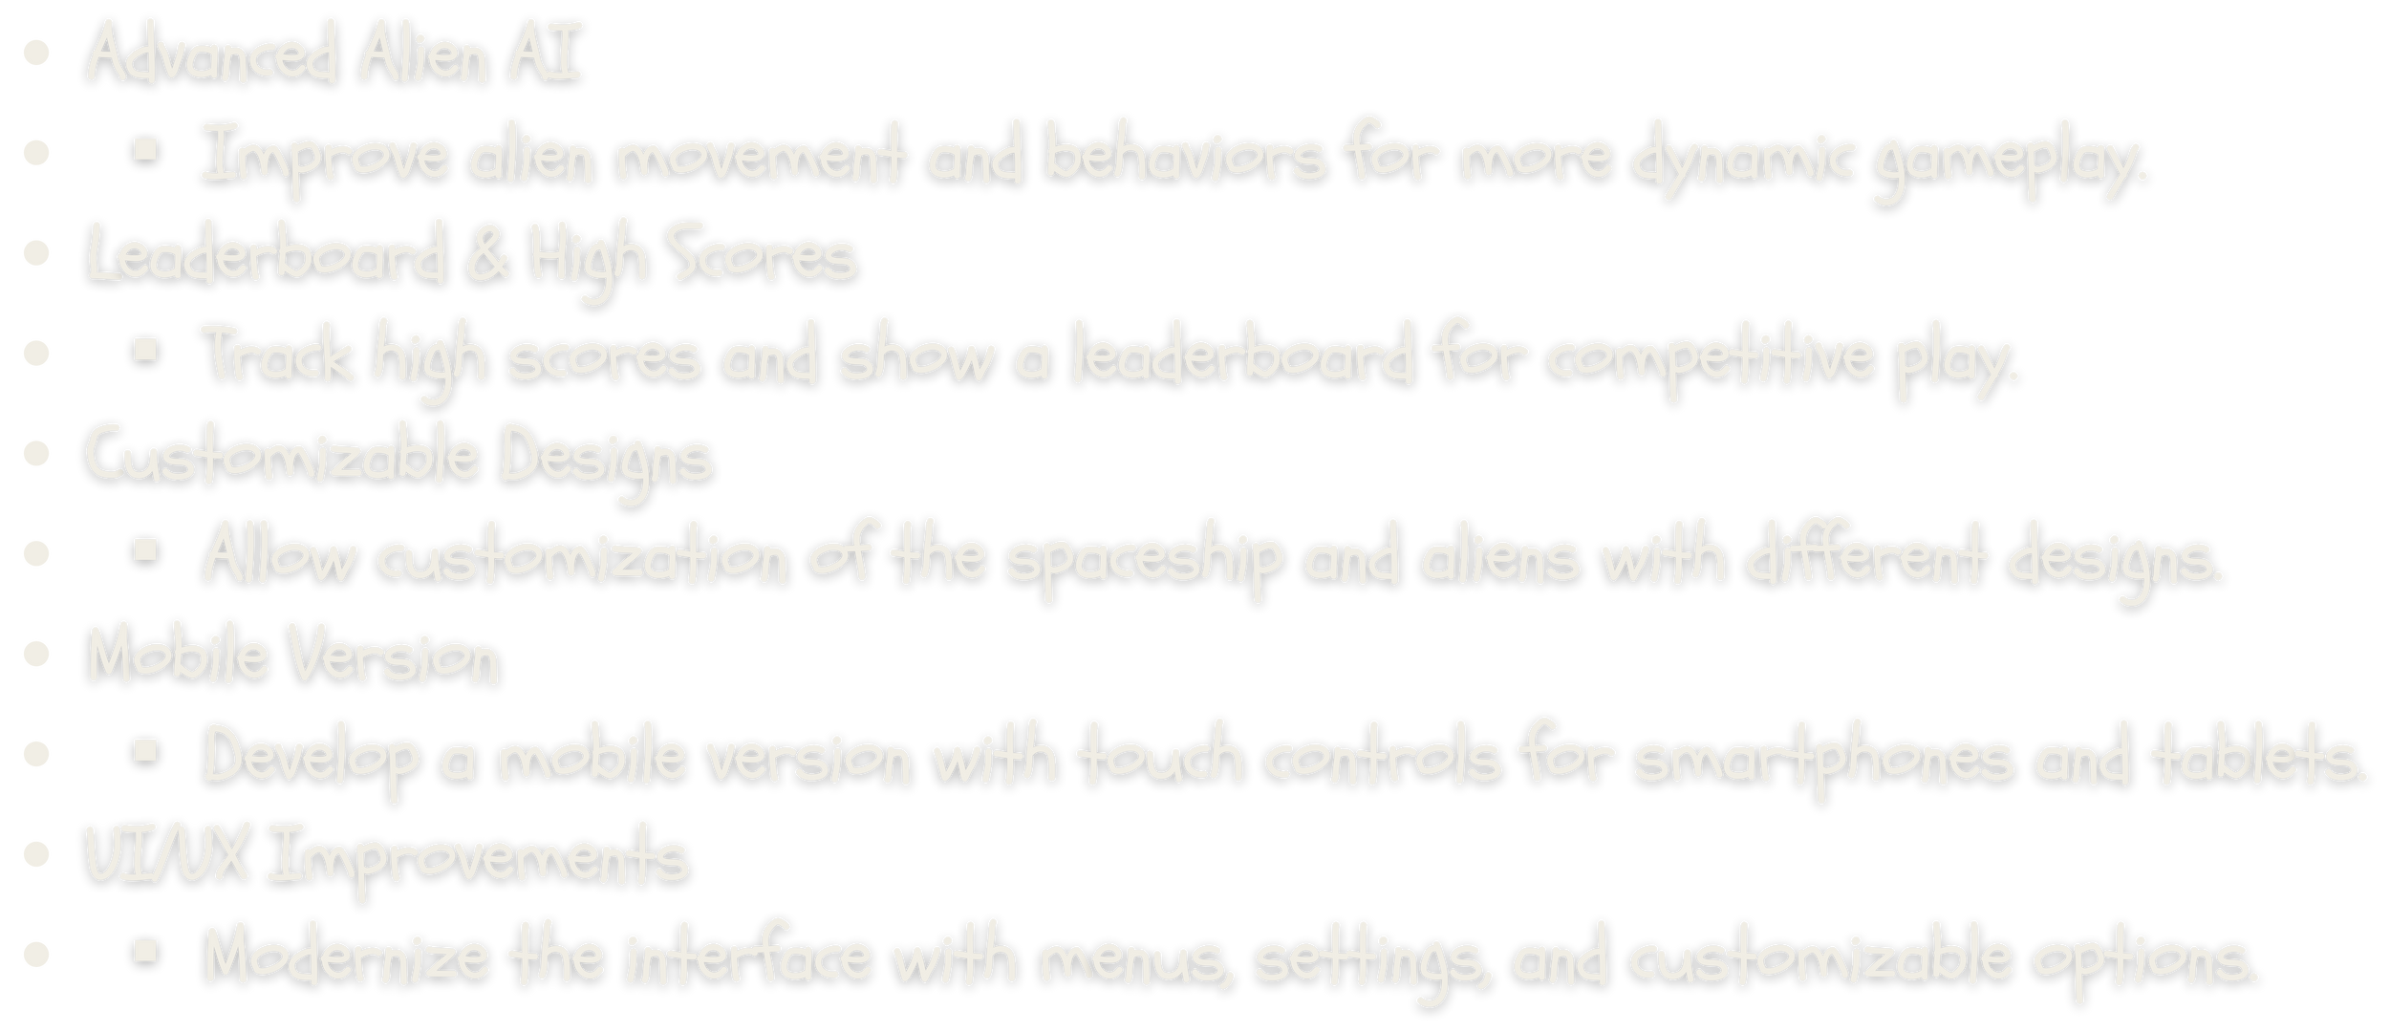
FUTURE ENHANCEMENTS
M.M. RUBAIET AHMED
NOSHIN ISLAM
GROUP 8
MAHIN AHMAD
MD. NAFIZ RAHMAN

Slide 12
CONCLUSION
THE SPACE INVADERS GAME CLONE IT'S ONE OF THE BEST PROJECTS FOR MASTERING SOME ESSENTIAL PROGRAMMING ASPECTS, INCLUDING GAME LOOPS, INPUT PROCESSING, AND COLLISION DETECTION. THIS PROJECT HELPS YOU BUILD A SIMPLE SHOOTER GAME USING C PROGRAMMING AND GAIN PRACTICAL EXPERIENCE IN PROCESSING REAL- TIME USER INPUTS, EXECUTING GAME LOGIC, AND DETECTING THE INTERACTION BETWEEN GAME ELEMENTS LIKE BULLETS AND ALIENS. THIS ALSO CEMENTS THE ROLE OF GOOD CODE FOR UPDATING MULTIPLE ENTITIES AS WELL AS RE-CALCULATING THE GAME STATE THROUGH CPU SIMULATIONS IN NEAR REAL-TIME. THIS PROJECT DOES NOT ONLY REINFORCE CORE PROGRAMMING SKILLS WHILE ALSO ACHIEVING SOMETHING MEANINGFUL BY PRODUCING A CLASSIC ARCADE-STYLE GAME — SO EDUCATIONAL AND FUN!
M.M. RUBAIET AHMED
NOSHIN ISLAM
GROUP 8
MAHIN AHMAD
MD. NAFIZ RAHMAN

Slide 13


Q&A SESSION

Slide 14



THANK YOU

